Slide 1

LOVABLE HACKATHON
Ctrl+Voice
Edit what you said.
In your own voice.
Notes:
1

Slide 2
You can’t edit speech.
WHAT YOU SAY
“I’m free on Thursday… no no no, on Wednesday.”
A typo takes one keystroke to fix. A spoken slip means re-recording, or sending it as it is.
Notes:
2

Slide 3


Slide 4
Speech in. Speech out.
Ctrl+F
Ctrl+X
Ctrl+V
Find
Cut
Voice
Locate the error in your recording.
Remove only that moment of audio.
Generate the fix in your voice, matched to the audio around it.
Text is only used to find the edit. What you get back is audio.
Notes:
3

Slide 5
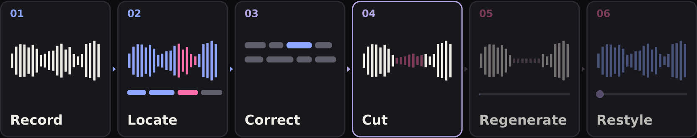
How it works
—
[speech-to-text model]
[small LLM]
—
[speech infill model]
[Voice2Voice model]
Notes:
Record the audio. Speech-to-text gives word timestamps (text is only a map). A small LLM decides what to fix. Cut that span. A speech model regenerates it, conditioned on the surrounding voice. Voice2Voice adjusts tone. Pronunciation path: one model finds mispronounced words, a speech-to-speech model re-speaks them.
4

Slide 6






What it does
Grammar
Word order
Tone
“he go home” → “he goes home”
“love I you” → “I love you”
Calmer or more formal, same message
Semantic undo
Replacement
Pronunciation
“Thursday, no no no, Wednesday” → “Wednesday”
Predicts what you meant and speaks it
Re-speaks only the mispronounced words
Notes:
Every fix is generated in the speaker’s own voice.
5

Slide 7


Live demo
BEFORE
AFTER
“I am free on Thursday, no no no, on Wednesday.”
“I am free on Wednesday.”
Same voice. Same recording. Only the mistake changed.
Notes:
6

Slide 8
Benchmarks
STEP
MODELS TESTED
METRIC
BEST
Timestamps
[model A, B, C]
Word timing error
[result]
Text correction
[LLM A, B, C]
Fix accuracy
[result]
Voice infill
[model A, B, C]
Voice similarity
[result]
Voice2Voice
[model A, B, C]
Listening test
[result]
Pronunciation
[model A, B, C]
Word error rate
[result]
Full pipeline
[chosen stack]
Latency per clip
[result]
Why we picked the models we picked. Fill in your measured numbers.
Notes:
7

Slide 9
The team
Antony
Nikoloz
[Name]
[Name]
[Name]
ML Engineer
ML Engineer
Data Analyst
MLOps / API Engineer
Software Engineer
Ctrl+Voice. Say it once.
Notes:
8

